Slide 1
Project Genesis Plus Re-engineer data flows into Snowflake and enable self-service Project Kickoff Presentation
November 8, 2022

Slide 2
Project Genesis Plus - Agenda
Data & Analytics – Vision & Strategic Priorities
Project Background & Problem Statement
Project Charter
Project Team
Solution Approach & Architecture
Project Tracks
Data Domain Track Approach
Consumption & Self-Service Track Approach
Schedule & Milestones
Appendix
Project Management - Agile
Risk Management Process
Communication & Meetings Cadence

Slide 3
Helen of Troy Data & Analytics – Vision & Strategic Priorities
Enable data driven decisions across HoT through increased awareness, reliable and accurate data, modern data platforms and easy to use tools for self-service
Strategy,& Operating Model
Business driven strategy & operating model to drive business value and innovation
Governance & Management
Organization, processes & tools to govern enterprise data lifecycle, data quality, business definitions, KPI’s & metrics
Platforms and Tools
Modern Data platform and consumption tools that simplifies data ingestion, enrichment, management and consumption
Business Analytics & Self-Service
Empower business to use governed self-service for business analytics – SC, Finance, Consumer, IoT, POS and other domains
Data Literacy & Culture
Raise data culture awareness through targeted training and ongoing engagement programs for all data stakeholders
DATA
INFORMATION
KNOWLEDGE
WISDOM
Notes:
5 foundational pillars, to achieve our goal, we need to make relative progress on all 5, because each of them are important and intersect
with each other.
All our projects and initiatives should fit one of these pillars

Slide 4






Project Genesis Plus – Background & Problem Statement
The current Oracle Data Platform cannot fulfill our vision to enable data driven decisions at all levels and increase data maturity across Helen of Troy.
Self-Service Needs
Definition / KPI’s
Can't self-serve or use for Adhoc needs
Lack of HoT standard definitions, metrics, & KPI’s
Drill-down Capability
Scalability
Cannot drill down to detailed level for decision making
Can't scale for performance, and different types of data
Data Trust
External Data Integration
Lack of Data Quality & ABC (Audit, Balance, Control)
Takes too long to bring new data in – POS, Competition, Weather, etc.

Slide 5
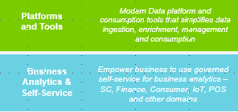

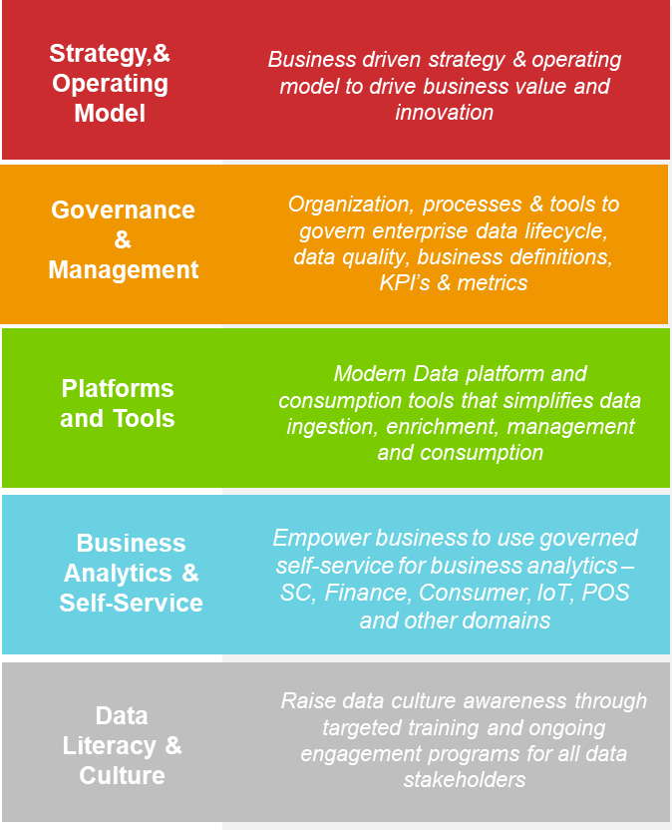
Project Genesis
STATUS
Business Objective
Implement Snowflake as the next generation HoT Data Platform Phase 1 - Replicate Oracle EDW into Snowflake Genisus Plus - Rationalize, migrate, sunset Oracle EDW investments & enable self service
Executive Sponsor
Harish Ramani
Project Management
Gayle Isles Rick Seiden | Gayle Isles
Business Stakeholders
All divisions, departments | Data Leadership Council Members | Raj Kasbekar
Project Team
Information Delivery Team – Sai, Venkat, Derek, Mel, Balaji
3 Onsite Consultants
10 Offshore Consultants
Executive Summary
Phase 1 – Replicate Oracle EDW into Snowflake - Live Workstream 1 – Data replication and data pipelines are completed Workstream 2 - UAT with ~175 business users is complete across EMEA, H&W, H&O, Beauty & SS Workstream 3 ETL tool selection, as well as phase 2 design, roadmap are complete We are live as of August and all reports and dashboard are driven from Snowflake Genesis Plus- Migrate, sunset Oracle EDW & enable self-service Data Domain Track – Build new data pipelines from all HoT internal and external sources into Snowflake Consumption Models & Self-Service – Define HoT Level measures, metrics, business definitions, KPI’s and implement in Snowflake for self-service consumption
Key Next Steps
Legal approval, and sign-offs for products & services Interview team members Project Kick-off Genesis Plus Team Onboarding & team training Design sign-off & Backlog Refinement
Key Risks / Issues & Resolution
❕ RISK: Dependency on external resources Mitigation: Interview each resource and use of multiple agencies ❕ RISK: Budget needs in FY24 Mitigation: Completion dependent on appropriate budget allocations in FY24
FY23 |  |  |  |  |  |  |  |  | FY24 | FY24
Q2 |  |  | Q3 |  |  | Q4 |  |  | Q1
June | July | August | September | October | November | December | January | February | March | April | May
Project Genesis Phase 1
Kick-off
Dev
UAT
Go-Live
Project Genesis Plus
Design
Prep
Kick-off
Design
Development
UAT
Go-Live

Slide 6
Genesis Plus – Team/Org Structure
Business (BU / Shared Service)
Engagement Sponsor
Harish Ramani
Finance
Edgar Hernandez, Hugo Olivares, Kevin Richardson, Vincent Martinez
Steering Committee
Tracy Scheuerman, Aloke Mishra, Marisol Ayala, Matt Dunn, H&W - TBD, Craig Antolik, Harish Ramani, Anil Johnson, Balaji Srinivasan
PMO
Gayle Isles
Balaji Srinivasan
Sai Pedditi
Orders To Cash
Alice Starliper, Lory Vasquez
Monica Saenzpardo
Procure To Pay
Romeo Chen, Jerri Bossie
Sherri Crawford, Edlyn Soler, Michelle Ortiz
Project Team
Delivery Team
Project Manager / Scrum Master
Rick Seiden
Product Owner
Sai Pedditi
Balaji Srinivasan
Logistics
Cedric Turnage, Moises Corral, Tonya Oliver
Business Analysts
Mel Blizzard
Derek Spear
Architecture & Design
Aditya Gondesi
Pablo Marotta
Venkat Marakala
Data Engineering
Gurpreet Singh,
Priyanka Meshram
Vinod Kumar
Venkat Marakala
Pradhnya Shahu
Open (2)
QA
Srinivas Maram
Neha Jain
Report Developers
Shivaram Kolla
Lakshmi Narayana
Data Leadership Council
Eric Proctor, Mike Burke, Gerritt Dewitt, Mike Wallenfels, Kirsten Augustad, Chris Fluhr, Brad Higginbotham, Anil Johnson, Tracy Scheuerman, Harish Ramani, Craig Antolik, Paul DeSousa, Melissa Allred, Melissa Villalon, Aloke Mishra
User Acceptance Tester(s)
TBD
Notes:
Merge into a vertical view

Slide 7
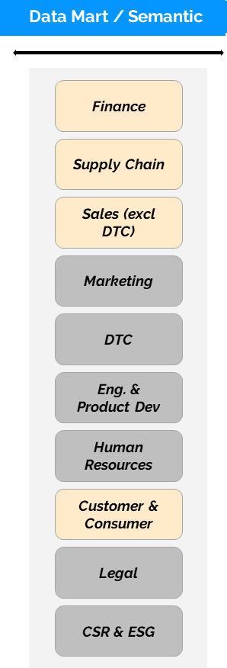

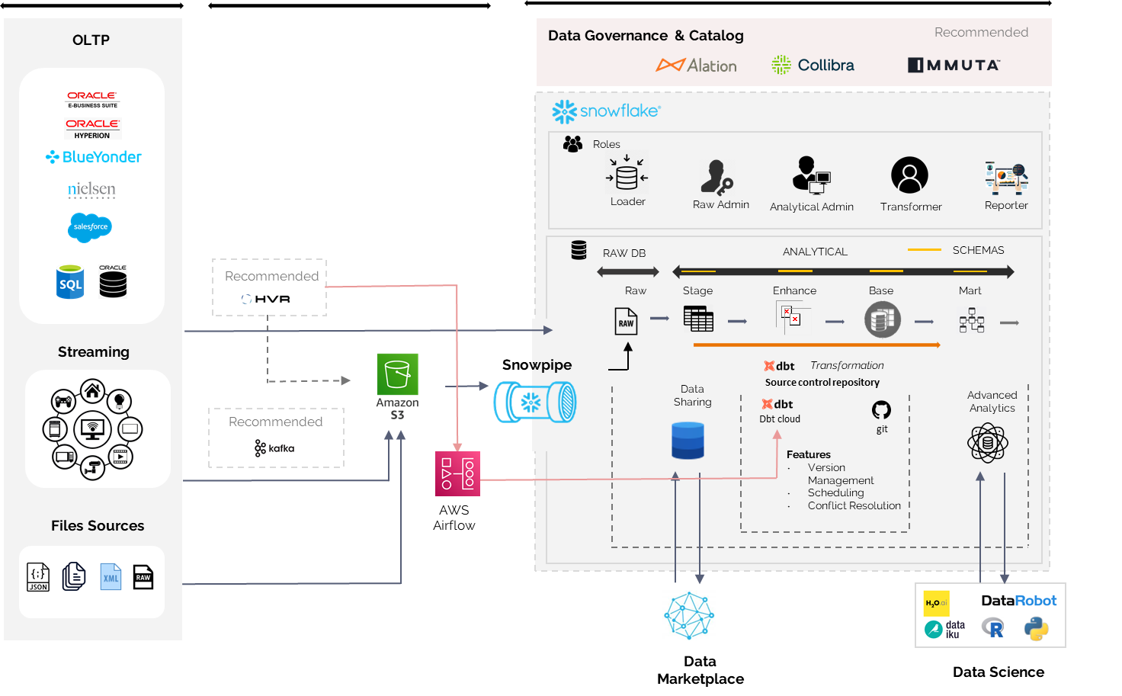







Genesis Plus Architecture
Data Domain Track - Build new data pipelines from all HoT internal and external sources into Snowflake
Consumption & Self-Service Track – Define & implement measures, metrics, definitions, KPI’s for self-service
Project Genesis – Snowflake Implementation
Business Self Service
Self Service Consumption Models
System Source
Extraction & Loading
Transformation
Current Tools
Future Tools
Ad-hoc
Data Exchange
* Represents currently available data & tools

Slide 8



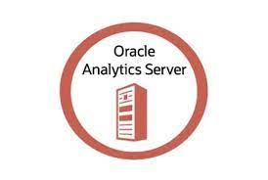







Project Genesis - Solution Approach – Current State, Phase 1 and Phase 2
Pre Genesis
On-premise ( Oracle ODI, Oracle DW, OBIEE)
OLTP
Databases
EDW
Stage
Reporting Tools
Enterprise
Applications
Genesis Phase 1
OLTP
Databases
Snowflake
Stage
EDW
EDW
Reporting Tools
Enterprise
Applications
Genesis Plus
On-Cloud (Matillion ELT, Snowflake / Redshift EDW)
Snowflake
OLTP
Databases
Snowflake
Snowflake
Financial Data Mart
Planning & Forecast Data Mart
ODS/Stage
EDW
Reporting Tools
Operations Data Mart
Sales Data Mart
Enterprise
Applications

Slide 9
Project Genesis - Solution Approach – Current State, Phase 1 and Phase 2
Pre Genesis
On-premise ( Oracle ODI, Oracle DW, OBIEE)
OLTP
Databases
EDW
Stage
Reporting Tools
Enterprise
Applications
Genesis Plus
On-Cloud (Matillion ELT, Snowflake / Redshift EDW)
Snowflake
OLTP
Databases
Snowflake
Snowflake
Financial Data Mart
Planning & Forecast Data Mart
ODS/Stage
EDW
Reporting Tools
Operations Data Mart
Sales Data Mart
Enterprise
Applications

Slide 10




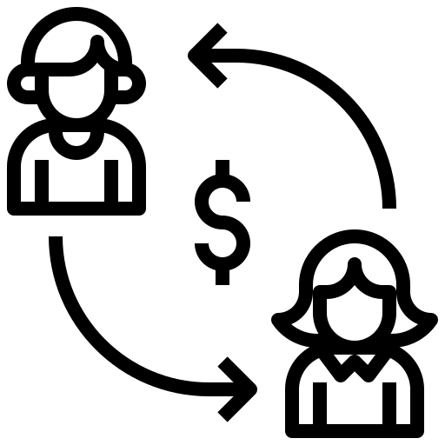

Project Genesis Plus – Data Domain Track
All data flows that supports our enterprise Oracle BI and Power BI reporting are being reengineered during this phase, to ensure data accuracy, we need validation and testing of key enterprise reports and dashboards
Master Data
Product, Customer
Track Activities
Finance
Requirements & Design
Reengineer Data ingestion
Build & Unit Test Data Pipeline
Orchestrate Data Jobs
User Acceptance Testing
Documentation & Deployment
AP, AR, GL, Accounting, Tax, Planning, Fixed Assets etc.
Orders to Cash
Order Management, CRM, Sales Operations, EDI etc.
Data Domain Validation & Testing
Procure to Pay
Supply Planning, Demand Planning, Procurement
Logistics
Sourcing, Distribution, Transportation
Notes:
Define Integrated Business Teams, grouped by domain / function
Define HoT & BU level definitions, measures, metrics, & KPI’s
Implement the aligned definitions in Snowflakes Semantic layer
Roll-out self-service in iterative manner

Slide 11
Genesis Plus – Data Domain Track Monthly UAT Approach
Identify UAT Testers
Communicate Testing Timelines to Testers
Domain Users Commence Testing
Domain Users Report Any Bugs
Bugs Addressed
Domain Users Tests Again
Domain User Sign-off
Monthly UAT Approach
~330 total reports will be tested, monthly breakdown TBD
~85 UAT users are expected, monthly breakdown TBD
Testers will identified & given three-week lead time to start testing
Monthly UAT will typically last one week
We expect about two hours of testing each month for each tester
Monthly UAT starts in Dec and ends in May
Notes:
Who, when, how long how do we engage, what are they expected to do??

Slide 12





Consumption Models & Self-Service Approach
Identify
Functional Leads & Team
Alignment
Align on Function Areas
IT Led & Business Supported
Business Led & IT Supported
5
6
7
Definition
Baseline Measures & Metrics, Business Definitions, KPI’s based on industry standards.
Implementation
UAT
Self-Service
Approval
Semantic Layer Snowflake
Business Testing & Sign-off
Power BI & other tools
Approval by the DLC team members
Notes:
Identify Domain leads & teams

Slide 13



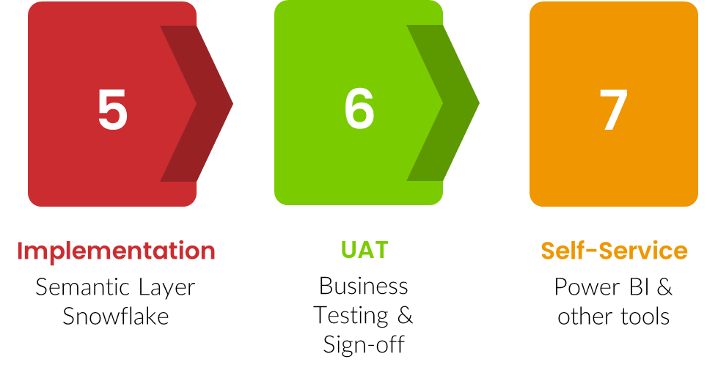
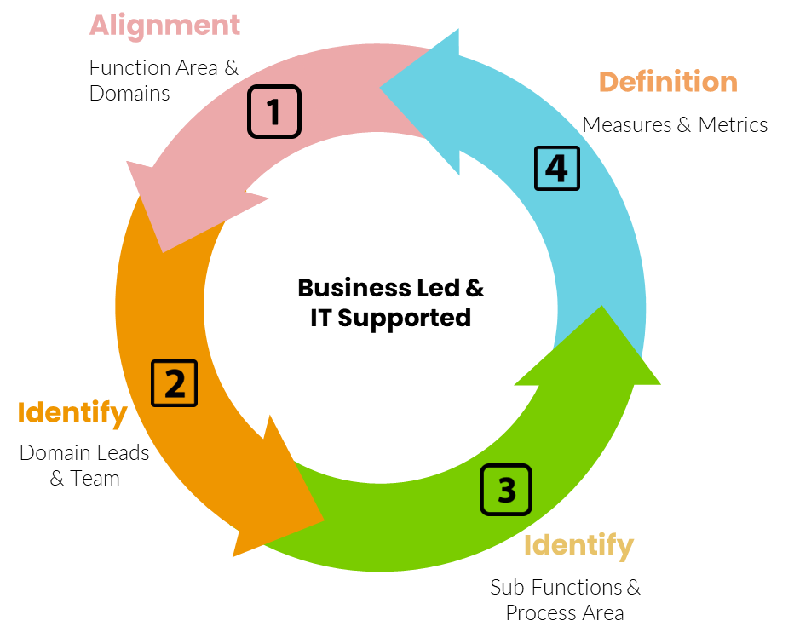
Project Genesis Plus – Schedule & Milestones
October
November
December
January
Feb
March
April
May
June
2022
2023
Data Domains
UAT
UAT
UAT
UAT
UAT
UAT
Requirements & Design
Master Data
Product, Customer
Orders to Cash
Order Management, CRM, Sales Operations, EDI etc.
Logistics
Sourcing, Distribution, Transportation
Procure to Pay
Supply Planning, Demand Planning, Procurement
Finance
Consumption Layers & Self Service
AP, AR, GL, Accounting, Tax, Planning, Fixed Assets etc.
Hypercare
Notes:
End of domain master data – you will get 1. Existing reports work

Slide 14
Appendix

Slide 15







Genesis Plus – Agile Project Methodology
Daily
Stand-up
Product
Owner
Team
Scrum Master
Sprint
Every 2 weeks
Sprint Review
+
Retrospective
v
Product
Backlog
Sprint Planning
Meeting
Sprint
Backlog
Finished
Work

Slide 16
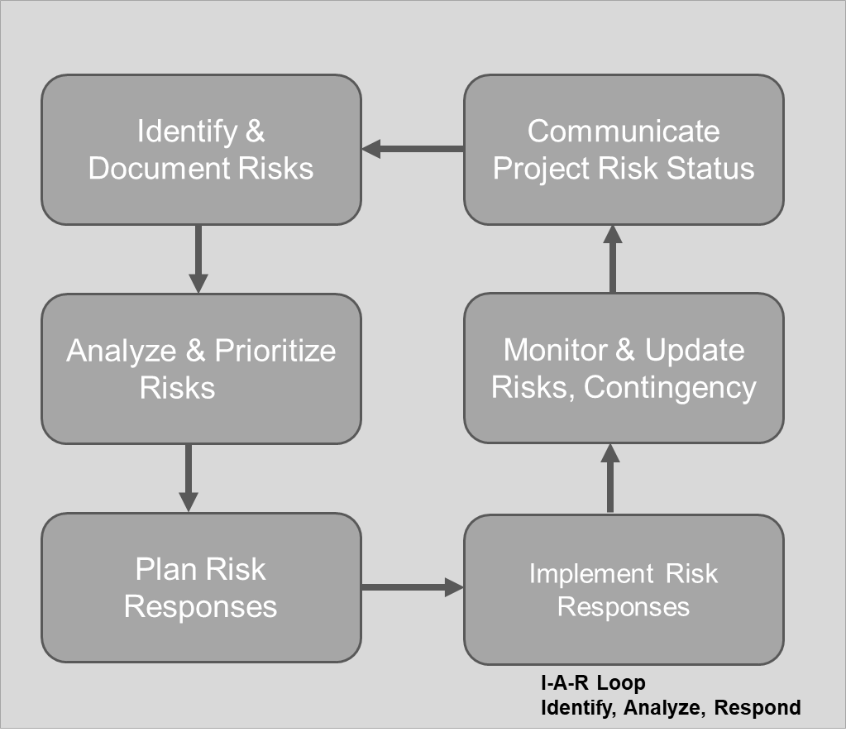
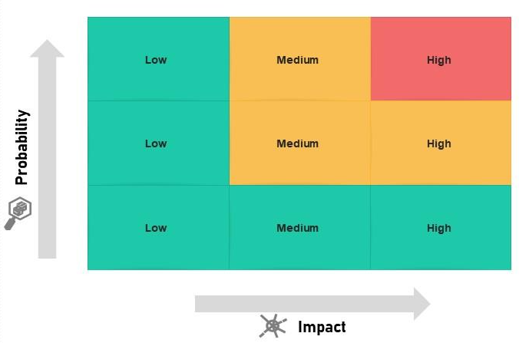
Genesis Plus - Risk Management Process

Slide 17
Genesis Plus – Communication & Meetings Cadence
Meeting | Timing | Duration | Purpose | Audience
Project Kick-Off | Day One | 2 Hours | Align stakeholders and Project Team | Helen of Troy Business Stakeholders
Project Status Meeting | Monthly | 30 Minutes | Updates on tasks and project status | Helen of Troy Stakeholders
Daily Standup | Daily | 15 Minutes | Ensure progress is trending towards completing the committed work | Identified Helen of Troy contributors (optional)
Risk Management Meeting | Weekly | 30 Minutes | Identify Risks, Categorize Risk, Mitigation Plan | Project Team, Helen of Troy Stakeholders
Sprint Retrospective | Bi-weekly | 30 Minutes | Openly discuss the sprint and areas of improvement for upcoming sprints | Identified Helen of Troy contributors (optional)
Exec Steering Readouts | Monthly | ~60 Minutes | Share findings and demonstrate features as part of delivery | Helen of Troy Stakeholders and general business

Slide 18
Thank You!

Slide 19






Project Genesis – Scope & Goals
MILESTONES
Implement Snowflake as the foundational data platform to process all internal (Oracle, Warehouse, Planning, DTC etc.), external (POS, Competition, Weather, etc.) data for enterprise analytics, and enable our business to self-serve using standard definitions, KPI’s, measures and metrics
Project Start
May 2022
Implement the Snowflake data platform, replicate data between Oracle DW and Snowflake and switch all reporting to Snowflake
Reengineer data flows from source systems, and standardize terminology to enable self service
Kick off
June 2022
Phase 1
Phase 2
Phase 1 Go-Live
Aug 2022
Team
Sponsor – Harish Ramani
PM – Gayle Isles, Balaji Srinivasan
IT – Information Delivery + 12 consultants
Business – DLC, All divisions / departments
Budget
Phase 2 Start
Nov 2022
Capex | Opex
844k | 350k
Project End
May 2023

Slide 20
Project Genesis Plus –Problem Statement & Benefit Case
The current Oracle Data Platform is obsolete and cannot fulfill our vision to become a data driven organization. We also lack data governance across HoT at segment and brands to drive consistent action
Standard KPI’s, Definitions, & Measures
Drill down capability to drive actions
Business Self-Service
Divisional definitions, hierarchies, KPI’s that don’t align across HoT
Only 3 people in IT build reports and dashboards for all of business
Current reports are either too high level or too detailed, driving actions need both at the same time
~150 people within the business performing silo analytics at different parts of business
Current BI platform is not usable / intuitive for business self-service, adoption is difficult
Lack of standard hierarchy impact ability to drill down from highest to lowest level
Business does not trust the data due to different terminologies and definitions
Standards and governance need to be established for self-service
Prioritize HoT level metrics ex: for margins, working capital, turns, etc and drive consistent actions.
Current platform performance also limits ability to drill down in reports
Need to enable best in class data consumption tools like Power BI for easier self-service

Slide 21
Project Genesis Plus –Problem Statement & Benefit Case
The current Oracle Data Platform is obsolete and cannot fulfill our vision to become a data driven organization. We also lack data governance across HoT at segment and brands to drive consistent action
Data Trust and Data Quality
Platform Reliability and Scalability
New platform capabilities
Lack of QA environment in current platform leads to high rate of production defects
Snowflake platform has an ecosystem of data providers that simplify data management
Business does not trust the data due to lack of transparency in how / when data is processed
Lack of Disaster Recovery capability, these are available out of box in Snowflake
Ability to compress the time needed to build new data pipelines for analytical purposes
Lack of trust also due poor data quality driven by multiple definitions, hierarchies, terms across brands and divisions
Instances of delayed reporting, and response time to load reports in current platform
Ability for data sharing, to anonymize and monetize our data within the Snowflake ecosystem
Business and IT spend significant time in verifying data quality rather than using the data for decision making
Snowflake offers many of the box capabilities for us to be compliant with privacy regulations like GDPR, CCPA etc.
Ability to instant clone helps improve budget & forecast load accuracy, and validation

Slide 22




Project Genesis Plus –Examples of Genesis benefits
The following are examples of completed or in-process activities that have a rapidly compressed timeline due to levering the capabilities within Genesis compared to our existing platform
ARA (Amazon Vendor Central ) Integration
Snowflake’s ecosystem allows us real-time access to Amazon Vendor Central info like PO, OTIF, Amazon’s forecasts, sell through, and inventory. This will help improve sales ops and planning for all our divisions @Amazon
Within a week, we have built a data model that includes all data domains sales, forecasts, inventory, POS, to drive the SKU rationalization program as well as provide to our internal and external partners for self-service
Pegasus - SKU Rationalization
Leverage Snowflake’s data ecosystem to rapidly build a scorecard to track macro economic indicators like CPI, CCI, Inflation, Interest rates, Unemployment, consumer debt etc from public data sources
Market KPI Dashboard
Platform – Disaster Recovery, Platform Stability & scalability
Instant benefits due to Snowflake’s platorm include Disaster Recovery, instances of delayed reporting, improved reporting performance, and budget & forecast load accuracy, validation due to instant cloning

Slide 23
Project Genesis – FY23 Budget
844k
350k
Capex
Opex
Committed
Planned
Not Planned
Committed
Planned
Not Planned
$363,505
$477,675
$2,820
$169,500
$115,000
$65,500

Slide 25
Project Genesis Plus –Problem Statement & Benefit Case
The current Oracle Data Platform is obsolete and cannot fulfill our vision to become a data driven organization.
Self-Service Needs
Definition / KPI’s
Enable the business to self-serve directly and immediately
Define HoT standard definitions, metrics, & KPI’s
Drill-down Capability
Scalability
Identify issues at the highest level and drive actions at lowest level
Scale our platform for performance, and different types of data
Data Trust
External Data Integration
Implement Data Quality and increase trust in data
Compress time to ingest and use new data ex: POS, Competition, Weather, etc.

Slide 26
Project Genesis Plus –Problem Statement & Benefit Case
Current State
Future State
Collaborate and formalize standard definitions, measures, metrics, KPI’s, hierarchies, across HoT
Enable our associates to better manage the overall business by leveraging data.
Prioritize HoT level metrics ex: for margins, working capital, inventory turns, planning indicators, procurement etc and drive consistent actions.
Identify & Formalize “analyst” group to self-serve to scale the use of data across HoT
Build reports and dashboards that comply with CoE guidelines.
Establish, share best practices, standards and governance for CoE operation.
Enable best of breed consumption technologies like Power BI, & others
BU focused solutions, not aligned at HoT level
Differentiated process / data maintenance at each BU / department
Divisional definitions / hierarchies / KPI’s that don’t align across HoT
Difficult to access data needed to drive decisions.
Lack of adoption of reports / dashboards across the organization.
~150 analysts acting as shadow BI within the business maintaining own versions of BI solutions, reports, dashboards
Lack of Trust in Data
Usability challenges with Oracle Technology
Current platform is end of life, can't meet current and future needs

